Slide 1
Introduction to SQL

Slide 2
Introducing SQL
The Structured Query Language (SQL) is the de-facto query language for modern relational database management systems (RDBMS).
All major, modern RDBMS support SQL. Database developers, administrators, and even software applications access RDBMS through the use of SQL.
Familiarity with SQL is essential for working with and understanding modern RDBMS.

Slide 3
Nature of SQL
SQL is a declarative language, where the developer specifies what he/she wants without specifying the details of how to perform the logic.
This is in contrast to an imperative language where the developer specifies how to perform the logic with a sequence of commands.
Modern imperative languages support control flow constructs, if conditionals, loops, variables, and functions/procedures.

Slide 4
Contrast of SQL to Java
SELECT first_name FROM person
WHERE last_name = ‘Smith’
Versus
Set<Person> personSet = getPersonSet();
List<String> firstNames = new ArrayList<String>();
for (Person person : personSet) {
if (person.getLastName().equals(“Smith”)) {
firstNames.add(person.getFirstName());
}
}
Notes:
Note that the SQL is actually doing much more than the example Java code, because it’s reading in tables from disk and operating in context of a transaction.

Slide 5
Another Key Differentiator
SQL is designed to work primarily, and naturally, with sets of data, more specifically, tables (two-dimensional structures) of data.
Modern imperative languages such as C#, Java, Visual Basic, and C are designed to work with many different forms of data, and are not especially designed to work with data sets naturally (Java 8 Streams are an exception).

Slide 6
Yet Another Differentiator
All data access and modification happens in the context of a transaction in SQL, which means its part of a larger task that is made permanent or rolled back atomically.
In imperative languages, code is just step-by-step and any atomic features must be coded, if needed.

Slide 7
Create a Table
CREATE TABLE TableName(
Column1 Datatype1,
Column2 Datatype 2…);
Example:
CREATE TABLE Person
(person_id DECIMAL(12),
first_name VARCHAR(256),
last_name VARCHAR(256));

Slide 8
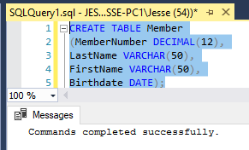
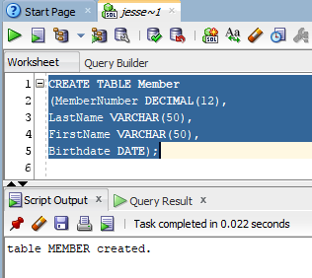
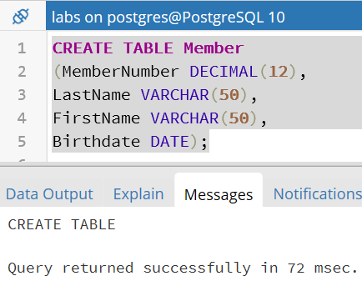
Create Table DB Execution
Oracle
SQL Server
Postgres

Slide 9
Add Data to a Table
INSERT INTO TableName (column1, column2…)
VALUES (Value1, Value2, …);
Example:
INSERT INTO Person (person_id, first_name, last_name)
VALUES (1, 'John', 'Smith');

Slide 10
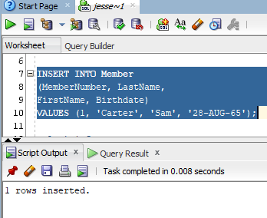
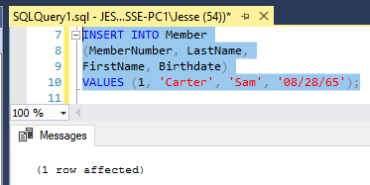
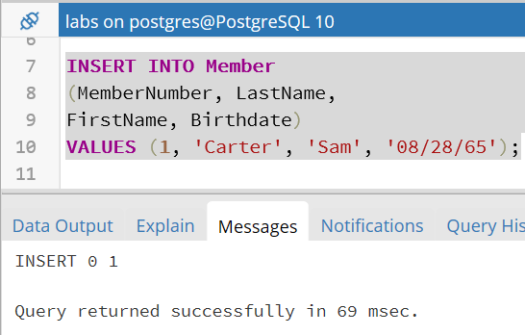
Add Data DB Execution
Oracle
Postgres
SQL Server

Slide 11
Retrieve All Data From a Table
SELECT *
FROM TableName;
Example:
SELECT *
FROM Person;

Slide 12
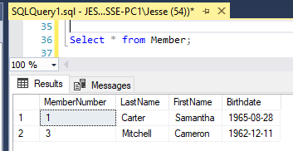
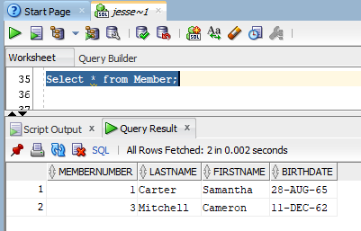
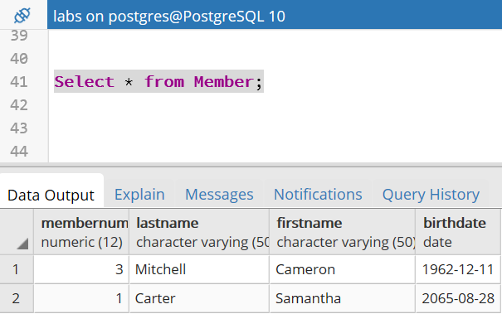
Retrieve Data DB Execution
Oracle
SQL
Server
Postgres

Slide 13
Retrieve Some Data From a Table
SELECT columnX, columnY
FROM TableName
WHERE columnZ = Value;
Example:
SELECT first_name, last_name
FROM Person
WHERE person_id = 3;

Slide 14
Modify Data in a Table
UPDATE TableName
SET columnX = Value
WHERE columnY = AnotherValue;
Example:
UPDATE Person
SET last_name = 'Glass’
WHERE person_id = 1;

Slide 15
Remove Data from a Table
DELETE FROM TableName
WHERE column = Value;
Example:
DELETE FROM Person
WHERE person_id = 2;

Slide 16
Drop a Table
DROP TABLE TableName;
Example:
DROP TABLE Person;

Slide 17
Joining Tables
Since data naturally contains relationships, to be effective in SQL you need to know how to set them up and retrieve related data.
In many ways, the richness and complexity of the relationships in a database determines its usefulness in answering important questions about the data.
We setup relationships with foreign keys, and retrieve related data with joins.

Slide 18
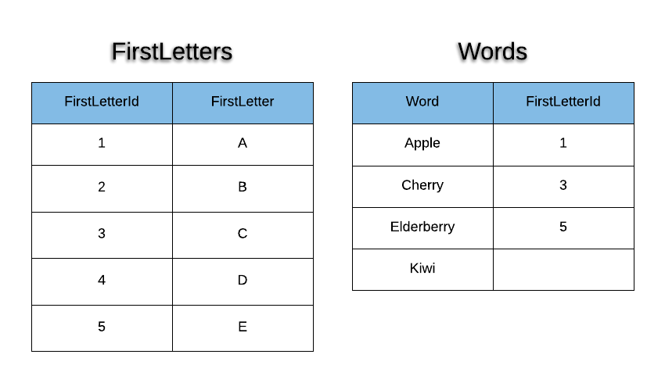
Simple Words Schema

Slide 19
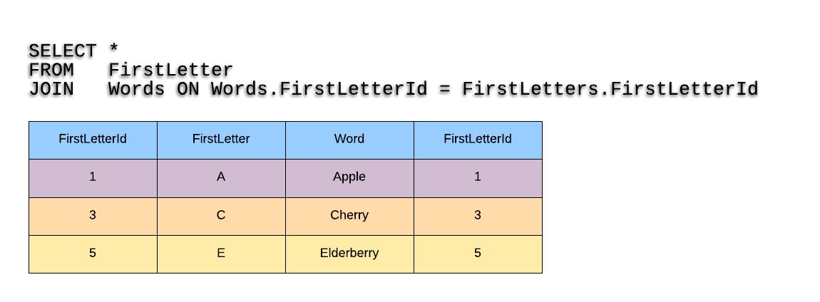
Words Inner Join

Slide 20
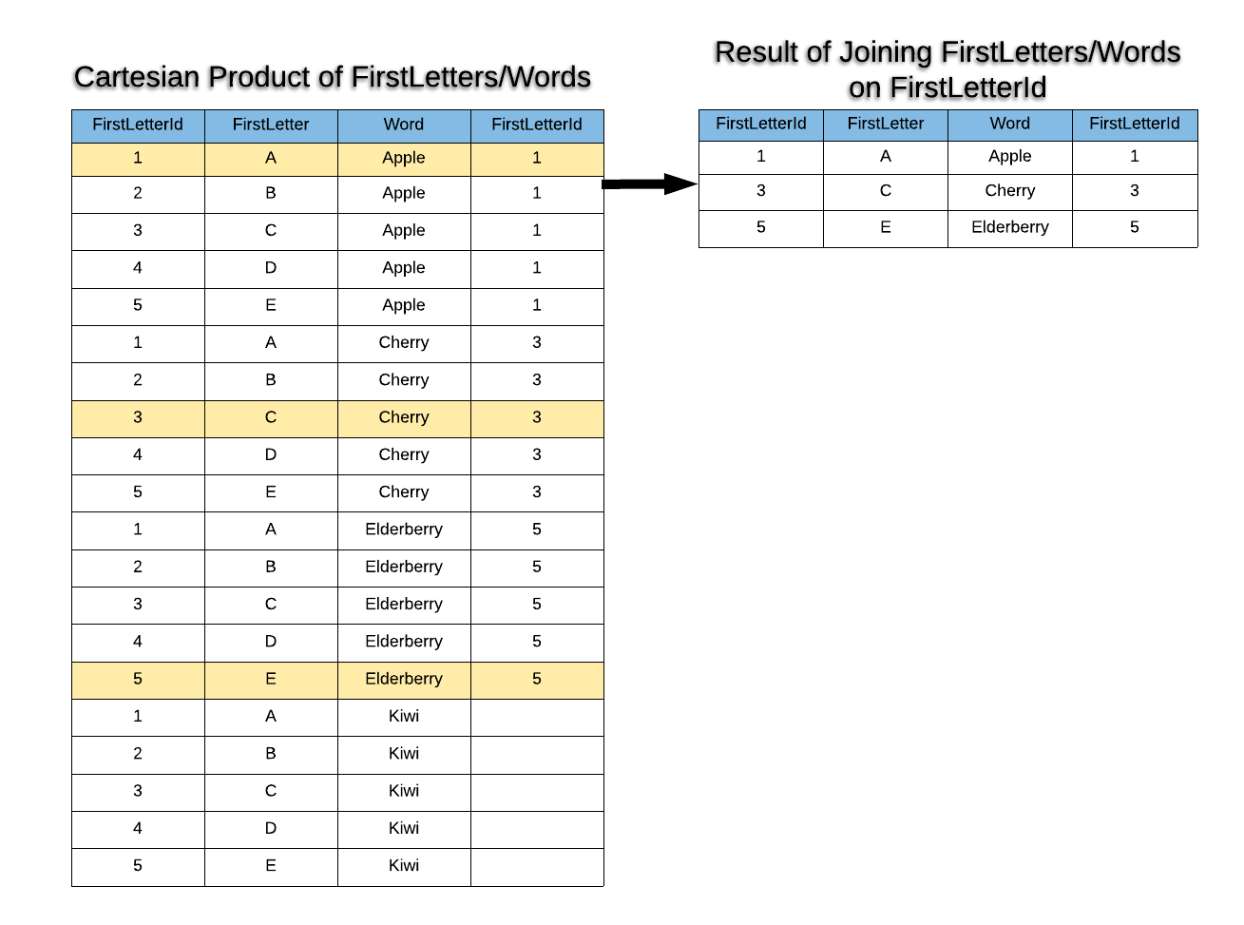
Words Inner Join Steps
Notes:
All joins conceptually start with the cartesian product!

Slide 21
Aggregate Functions
Standard Function | Aggregate Function
Always yields one result per row | Always yields a single value across all rows, or across groups of rows
For input, always uses value(s) from a single row of data | For input, uses multiple rows of data

Slide 22
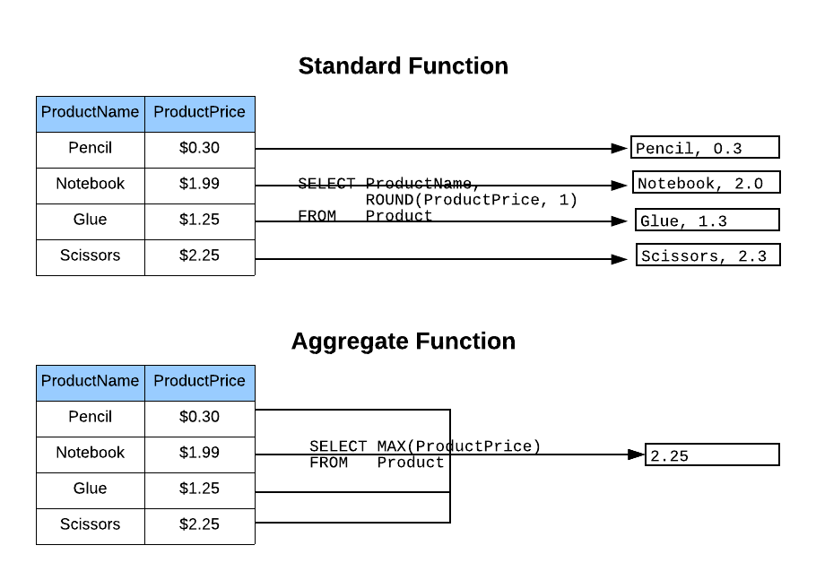
Side-by-Side Comparison

Slide 23
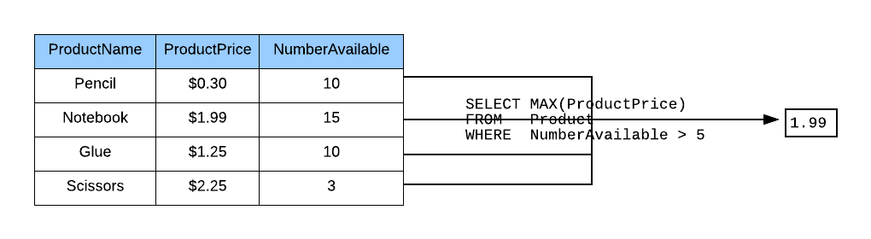
Combining with WHERE Clause

Slide 24
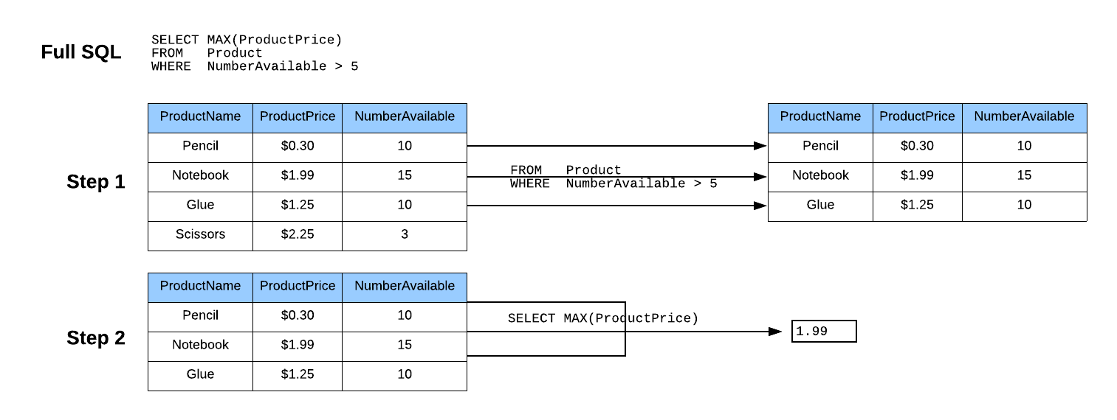
Order of Operations
Notes:
This is the order of operations conceptually; however, a database may well use a different order for performance, while still guaranteeing these results.

Slide 25
Common Numeric Functions
Count – Counts the number of rows or the number of rows without a null for a column.
Min – Returns the smallest number (or date) in the result set for a column.
Max – Returns the largest number (or date) in the result set for a column.
Sum – Adds up the values in a column across the rows in the result set.

Slide 26
Groups
By default, an aggregate function is executed across all rows in the result set.
Alternatively, rows can be grouped together, and an aggregate function can be executed one for each group.
The GROUP BY keyword specifies which column(s) define the group.
With GROUP BY, the aggregate function is executed once for each unique value for the column, or combination of unique values if more than one column is specified.

Slide 27
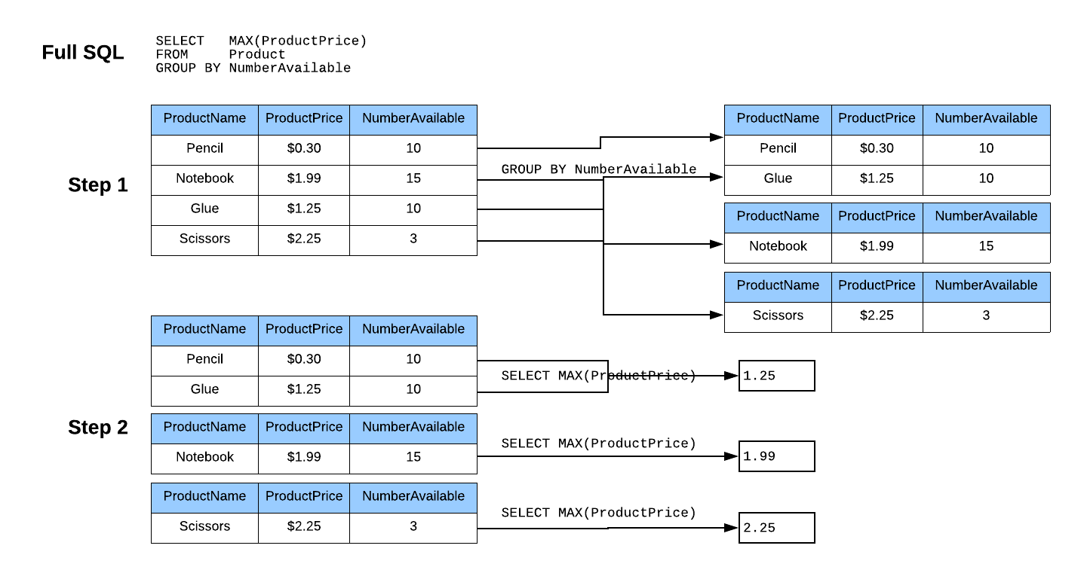
Group Order of Operations

Slide 28
Ordering Results
Without explicitly ordering results, the result set will contain rows in an arbitrary order.
The ORDER BY statement explicitly orders rows in the result set by a column or set of columns.
The ORDER BY can ordered ascending (smallest to largest) or descending (largest to smallest).

Slide 29
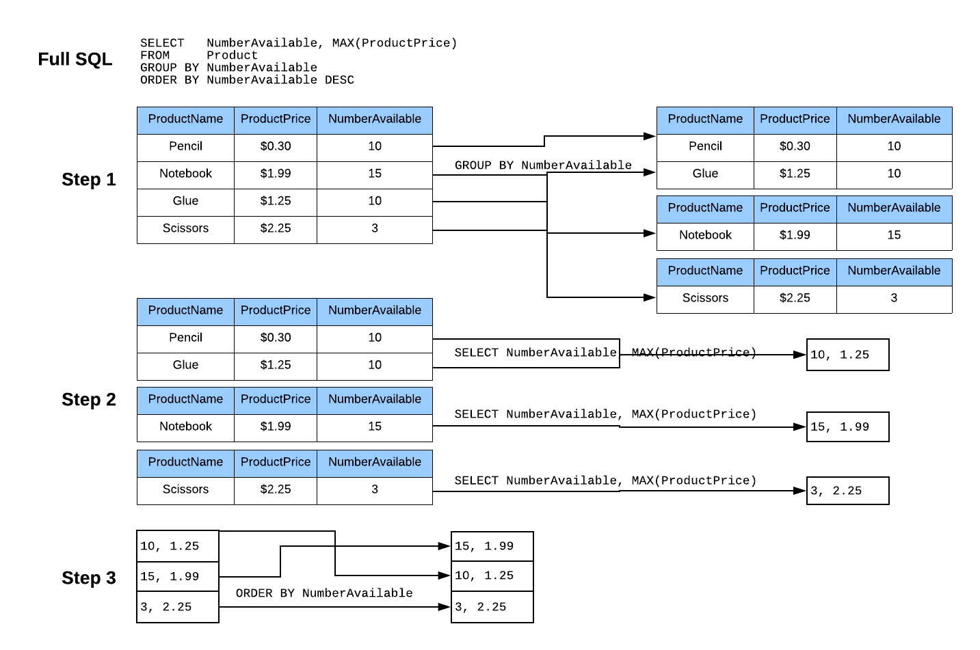
ORDER BY Order of Operations

Slide 30
Order of Operations Summary
FROM – Specifies which tables to pull data from.
WHERE – Filters individual rows based on conditions.
GROUP BY – Groups fields for aggregate functions.
HAVING – Filters rows based upon aggregate values.
SELECT (Column List)- Selects which columns and aggregates to keep in the result set.
ORDER BY – Orders the result set by one or more selected columns.

Slide 31

End

